Slide 1
Super Mega Awesome Budget Pro – V 3.0 (a.k.a. Budget Buddy)
Peter Krause – Back End
Andrew Miller – Front End
Jackie Golden – Graphing

Slide 2
About
Budget Buddy is a budgeting application for our everyday life.
It helps you keep track of how much you spend on specific categories.
Food/Dining, Entertainment, Transportation, Etc.
It will graph the data and provide useful feedback on average spending on categories as well as percentages.

Slide 3
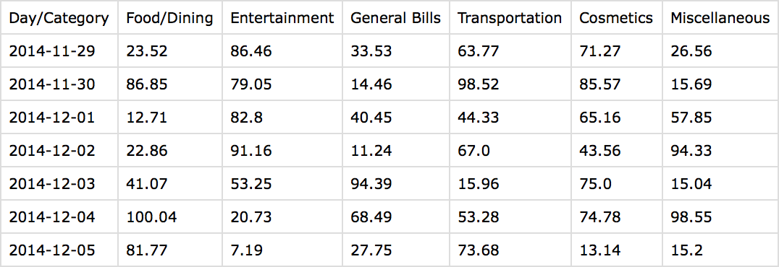
Back End
The application is written in Python.
We used Tkinter, PyQT, and Python
The data is stored in a comma separated value file.
Dates on the left, categories on the top

Slide 4
Front End
The front end uses PyQT for frames, text, graphs etc.
It provides a Intuitive User Interface for modifying the information stored in the back end.
It displays the graphs on the left, Actions on the right, and info at the bottom.

Slide 5
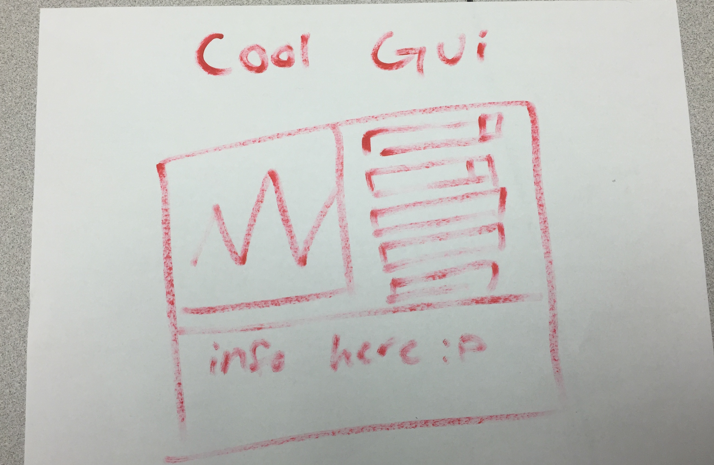
In app screenshot

Slide 6
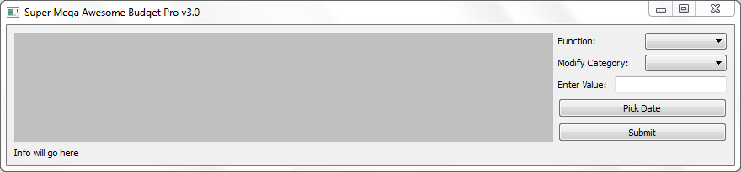
But seriously…

Slide 7
Base Features
Adding/Subtracting
Resetting Cell/Date
Getting averages
Per Month/Per Year/Overall
Getting percentages
Per Month/Per Year/Overall
Graphing
Per Month/Per Year/Overall
Totals
Data Updating
Data will update on load, keeping the info on the current date.

Slide 8
Graphing
Graphs will have multiple views
Total by day/Total by Month/ Totals All Categories
Each line in the graph will be toggle-able
You can hide or show individual lines in the graph.
You can sort by different kinds of amounts.
i.e. you can show percentage amounts, averages, etc.

Slide 9
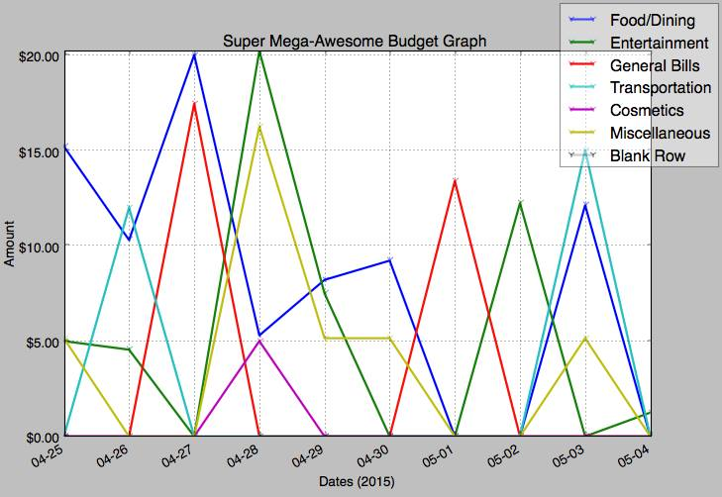
Graphing

Slide 10
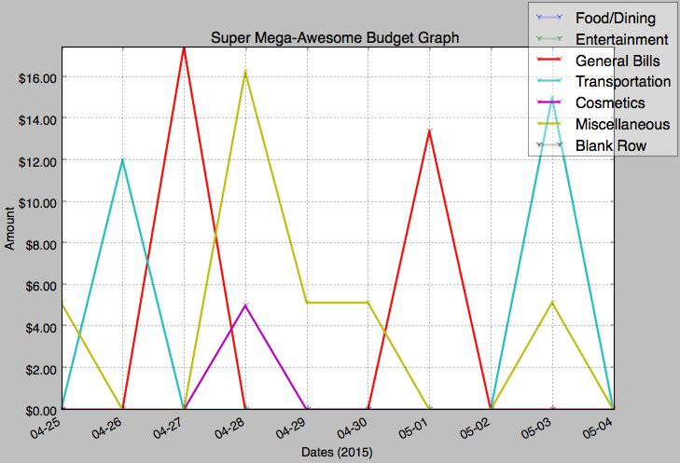
Graphing

Slide 11
Conclusion
Planned features
Questions?

